Slide 1


SECTION: B GROUP 2
TONMOY
SUTRADHAR
22-46568-1
Explanation of Application areas and violation in various fields

Slide 2
Drone Delivery System by SwiftTech BD

Slide 3
SECTION: B GROUP 2
TONMOY
SUTRADHAR
TRIDIB
SARKAR
MD MEHEDI
HASAN
POLASH
22-46568-1
22-46444-1
22-46566-1

Slide 4

The IEEE Code of Ethics pertains to the ethical guidelines established by the Institute of Electrical and Electronics Engineers (IEEE), which is a leading professional organization for engineers and technical professionals. These guidelines aim to ensure the integrity and professionalism of IEEE members in their work.
Background of IEEE Code of Ethics

Slide 5
INTRODUCTION
The IEEE Code of Ethics I.1 emphasizes that engineers must prioritize the safety, health, and welfare of the public in their professional practices.
It requires engineers to make decisions that do not compromise these aspects, even under pressure from other parties such as employers or clients.

Slide 6
01
02
Product Design and Development
Manufacturing
03
04
Data Handling
Environmental Impact
Implications and Application Areas
in the Professional Field:

Slide 7

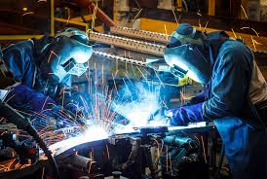
Product Design and Development
Engineers must ensure that their designs do not pose risks to users. This involves rigorous testing and adherence to safety standards.
Manufacturing
Manufacturing processes must include quality checks and fail-safes to prevent defective products from reaching the market.

Slide 8
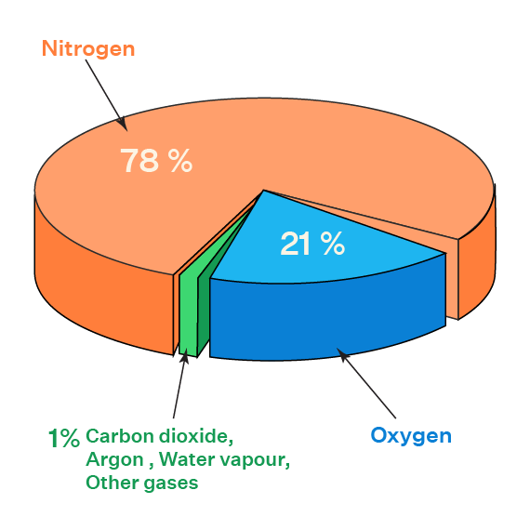

Data Handling
When dealing with sensitive information, engineers must ensure that data privacy and security measures are in place to protect users.
Environmental Impact
Manufacturing processes must include quality checks and fail-safes to prevent defective products from reaching the market.

Slide 9
Consequences of Violating the Code
Legal Repercussions
1.
2.
Loss of Trust
Injury or Death
3.
4.
Financial Loss
Violating safety and health standards can lead to lawsuits, fines, and sanctions.
Public trust in technology and engineering can be severely damaged
Compromising on safety can result in accidents, leading to injuries or fatalities.
Companies may face significant financial losses due to recalls, reparations, and loss of business.

Slide 10
SECTION: B GROUP 2
TRIDIB
SARKAR
22-46444-1
CASE STUDY

Slide 11
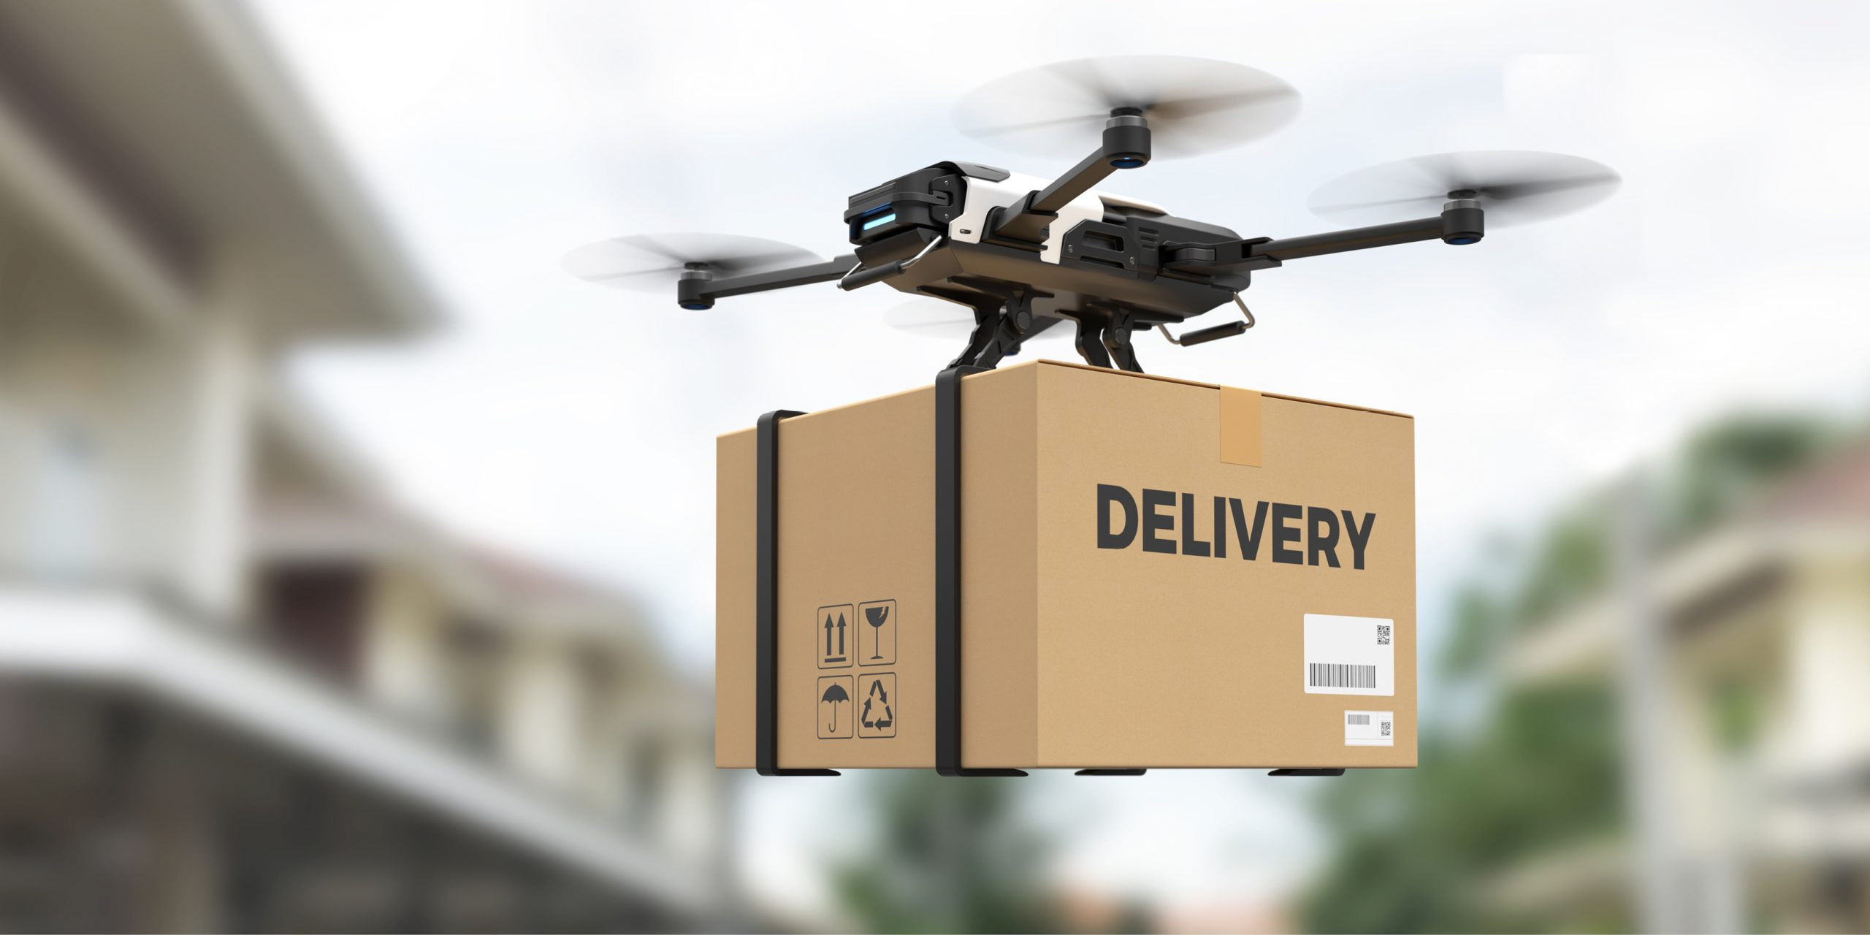
ENVIRONMENTAL CONSULTING
CASE STUDY
Drone Delivery System by SwiftTech BD

Slide 12
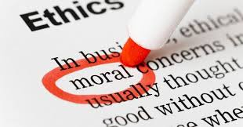
CASE STUDY
SwiftTech BD, a pioneering Bangladeshi company in drone delivery systems, has secured a contract with DARAZ, a renowned online shopping company. The agreement entails SwiftTech BD providing advanced drones for DARAZ's package delivery operations, promising to revolutionize their logistics with quicker and more efficient delivery solutions. However, a critical flaw has been identified in the drone’s navigation system during the testing phase. Under specific environmental conditions, such as strong winds, the AI misinterprets GPS signals, leading to potential loss of control and crashes. This issue presents an ethical dilemma that directly impacts public safety and the company's integrity.

Slide 13
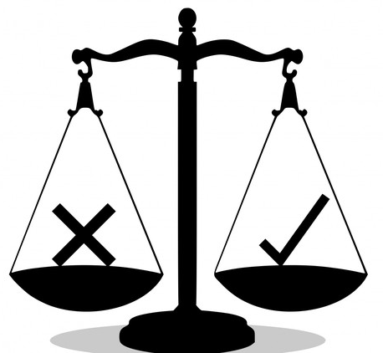
There are two options the company can offer.
1.Fix the Issue Before Deployment.
If we fix the issue before deployment, it will cause Short-term damage to the company’s image and reputation as a reliable partner.
Additional costs and resources required to resolve the technical flaw.
2.Deploy the Drones Without Disclosing the Issue.
High risk of drone crashes, posing serious threats to public safety and potential injuries or fatalities.
Long-term damage to the company’s reputation if the issue becomes public, leading to loss of trust, legal actions, and potential business failure.
Violation of the IEEE Code of Ethics I.1, compromising professional integrity.

Slide 14
SECTION: B GROUP 2
MD MEHEDI
HASAN
POLASH
22-46566-1
Violation of IEEE Code of Ethics I.1: Safety, Health, and Welfare of the Public

Slide 15

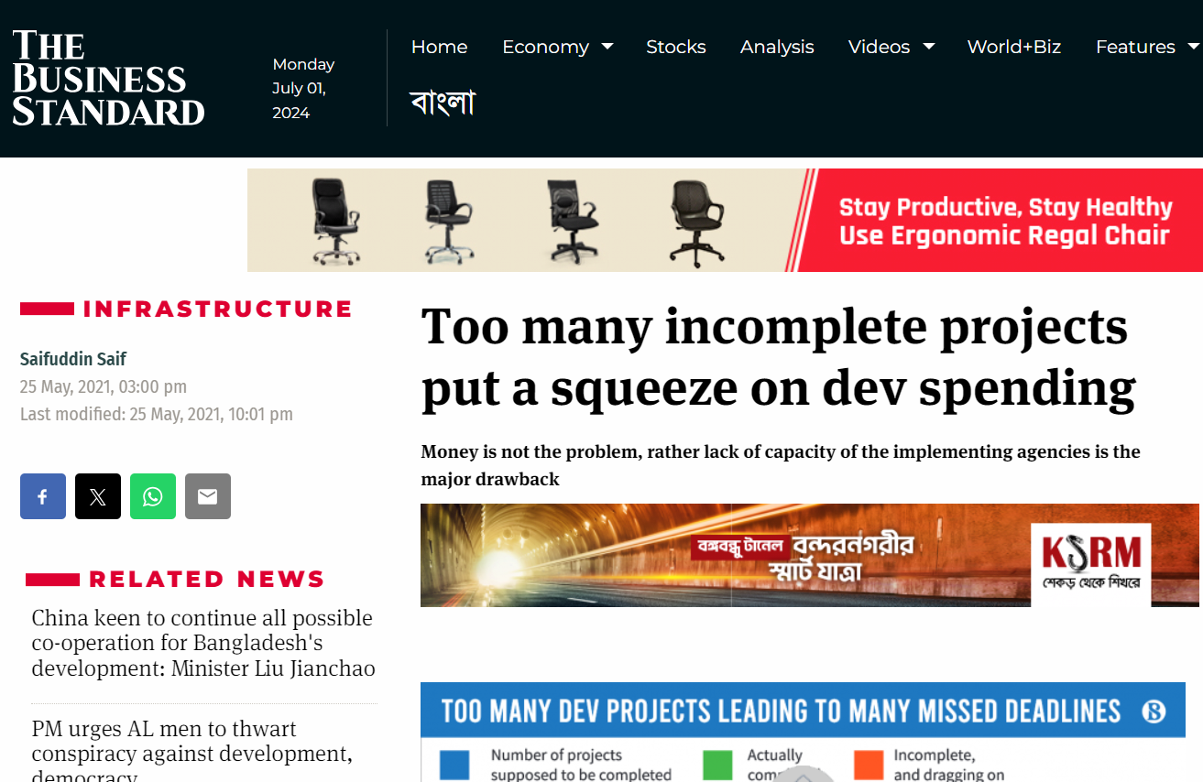
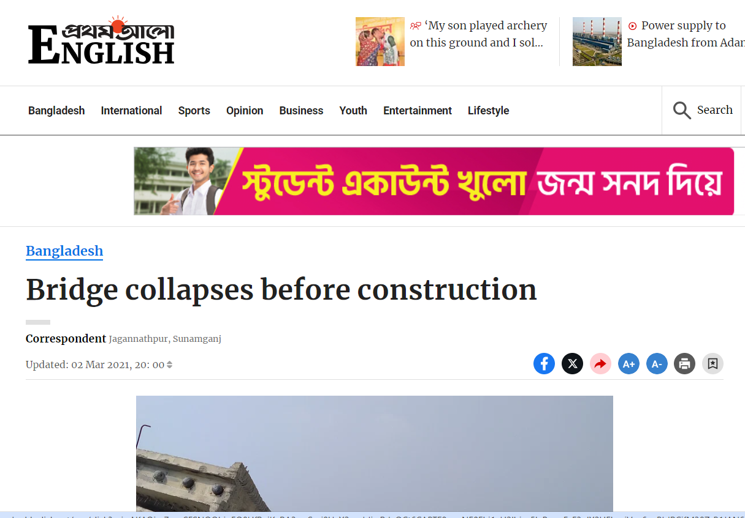
From many real-life incidents nowadays suggests that a lot of companies have this practice of breaking the ethical standards and as a result it causes unavoidable long-term consequences for both the company and the public.
Project Failures Lead to Long-Term Losses

Slide 16
Violation of IEEE Code of Ethics I.1
Issue Identified
50%
25%
The problem with the drone's navigation system is very dangerous for public safety. If it fails, drones could crash in busy areas, leading to injuries, property damage, and losing people's trust in drone technology.
Ethical Design and Sustainable Development Practices Issue Identified
The initial design and development processes need to include more comprehensive risk assessments and safety evaluations to prevent such flaws from occurring.

Slide 17
Violation of IEEE Code of Ethics I.1
Privacy Protection Issue Identified
75%
The drones collect vast amounts of personal data from customers , including sensitive information about delivery locations and personal items. If the drone fail to fly at often, it will be a privacy issue for the public.
Disclosure of Factors Endangering the Public or Environment Issue Identified
100%
The potential risk from the navigation flaw needs to be clearly communicated to maintain public trust and ensure accountability. If the drone can't handle this kind of pressure, it will lead to failures for the users and give the company a bad reputation.

Slide 18
Resolution Using the Four-Step Analysis:
1.Moral Clarity
2.Know the Facts
3.Consider Options
4.Make a Reasonable Decision
SwiftTech BD’s management and engineering team must recognize that manipulating testing data is unethical.
The engineering team should gather all relevant facts about the navigation flaw, including documented evidence of how the AI misinterprets GPS signals under specific conditions.
Fix the Flaw
Transparency
External Review
SwiftTech BD must make a decision that prioritizes public safety.

Slide 19

In this scenario, the best decision for SwiftTech BD is to fix the issue before deployment. This approach aligns with the IEEE Code of Ethics I.1, which emphasizes the importance of prioritizing public safety and integrity. Addressing the flaw enhances the reliability and performance of the drones, ultimately benefiting both SwiftTech BD and DARAZ in the long run.
Making a Reasonable Decision

Slide 20
In conclusion, by prioritizing public safety and adhering to professional integrity as outlined by the IEEE Code of Ethics, SwiftTech BD not only upholds its ethical obligations but also demonstrates true professionalism. This commitment to ethical standards and transparency is likely to be recognized and rewarded in the long term, fostering trust and respect from partners, customers, and the broader community. Moreover, taking the morally right action reflects a deeper sense of responsibility that transcends immediate business concerns, affirming the values that will ultimately be rewarded in both professional and spiritual dimensions.
CONCLUSION

Slide 21
Thanks!
Do you have any questions?
]]

